Slide 1

Exploring AWS Spot Instances within
Kubernetes clusters
Under the guidance of Dan McPherson and Ravi Gudimetla
Course: EC 528 Cloud Computing
Professor: Orran Krieger
Aditya Kadam
Kevin Rodrigues
Nikhil Singh
Suryateja Gudiguntla

Slide 2
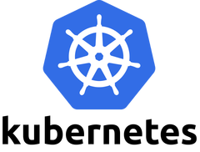
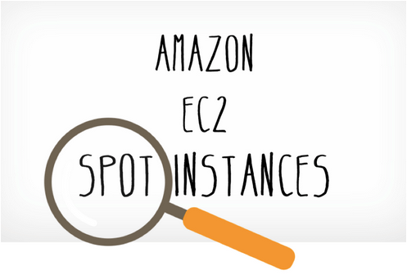
Background
EC2 Spot Instances
Amazon EC2 Spot Instances offer spare compute capacity available in the AWS cloud at steep discounts compared to On-Demand instances at a risk of being terminated at any moment.
Kubernetes
Kubernetes is an open-source container orchestration system for automating application deployment, scaling, and management.
Notes:
Ec2 spot instances are the spare compute capacity available in AWS. They are offered at a cheaper rate compared to On demand Instances as they have a risk of being taken away at any moment.
Kubernetes is an open source container orchestration system which we using for managing our cluster

Slide 3
Motivation
Developers prefer On demand instances within Kubernetes cluster as it is risk free and easier to manage compared to Spot instances
Using Amazon’s Elastic Kubernetes Service (EKS) we can manage Spot Instance, but it charges you $150 per month for running the control panel in addition to cost of running nodes which host the application
Notes:
Developers usually prefer on demand instances as they are risk free compared to spot instances. But cost of running an application on on demand is higher. Also you can use Amazon EKS to manage spot instances but it charges you $150 per month for running an application.
If you are administrating kubernetes cluster you dont have to pay the extra 150$ EKS cost.
// add cost of without eks cluster, and compare it with spot instances
// mention size and relation to cost of node

Slide 4
Solution
Create a controller which sits on top on of Kubernetes and
Manages an application that runs on spot instances within a Kubernetes cluster in a cost effective way
Optimizes the number of spot instances dynamically
Maintains Service Level Agreement (SLA)
Notes:
The solution to this is to come up with a controller which sits on top of Kubernetes cluster and it
Runs an application using spot instances within Kubernetes in a cost effective way
It also optimises the number of spot instances dynamically while maintaining SLA
// SLA is only for the application is maintained
// for multiple applications, SLA is maintained for every application
// Explain controller
//

Slide 5


Tools Used
Kops (Kubernetes Operations)
Helps to create, destroy and upgrade clusters from command line
Prometheus (Monitoring tool)
Collects metrics from configured targets at given intervals
Displays the results
Sock-Shop (Demo Application)
The application is the user-facing part of an online shop that sells socks.
It is intended to aid the demonstration and testing of microservice and cloud native technologies.
Notes:
Kops helps to create, destroy and upgrade clusters from command line
Prometheus is a monitoring tool which collects metrics from configured targets at given intervals
Sock shop is a demo web application which we have used and deployed on our cluster for testing

Slide 6
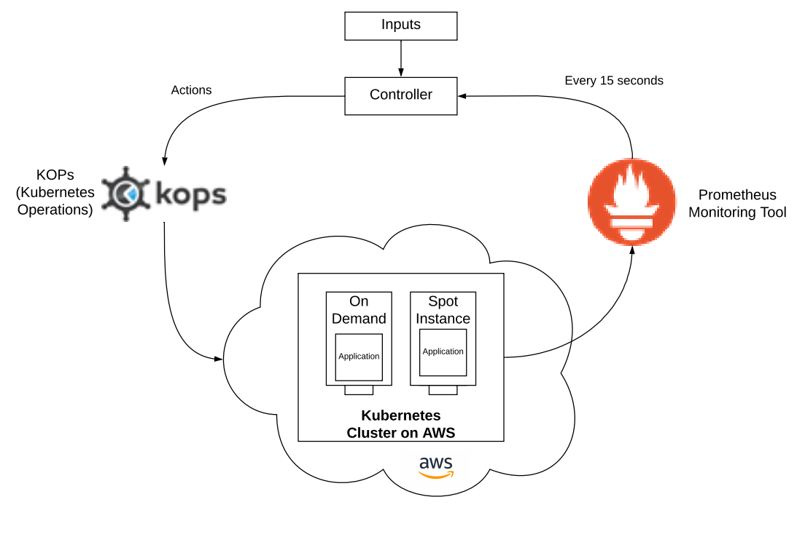
Workflow
Notes:
// detail the inputs as a config file
// config instead of input

Slide 7
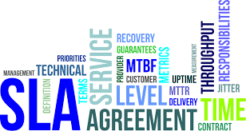
Target SLA
A service level agreement, or SLA, is a common term for formal service commitments that are made to customers by service providers.
The target SLA for this application is set to have availability of 99% (“two nines”)
Availability is defined by these Service Level Indicators (SLIs)
Throughput: More than 96%
Error Rate: Less than 4%
Latency: Less than 1.5 seconds
Notes:
We have set the target SLA for our demo application to have 99 percent availability and we calculate availability in terms of throughput , error rate and latency.

Slide 8
Budget
Budget is the quota which we have in terms of SLA that allows our application to perform below set thresholds.
Budget is increased after a specific time interval.
Anytime our application performs below a certain threshold, we reduce some amount from the budget
For our application, we have defined the budget to be 15 mins per day.
Notes:
For eg Our sla is defined as 99 percent availability. So we have approximately 15 mins of slack per day where our application can work below defined thresholds.
// explain algorithm with a flowchart then explain the term budget

Slide 9
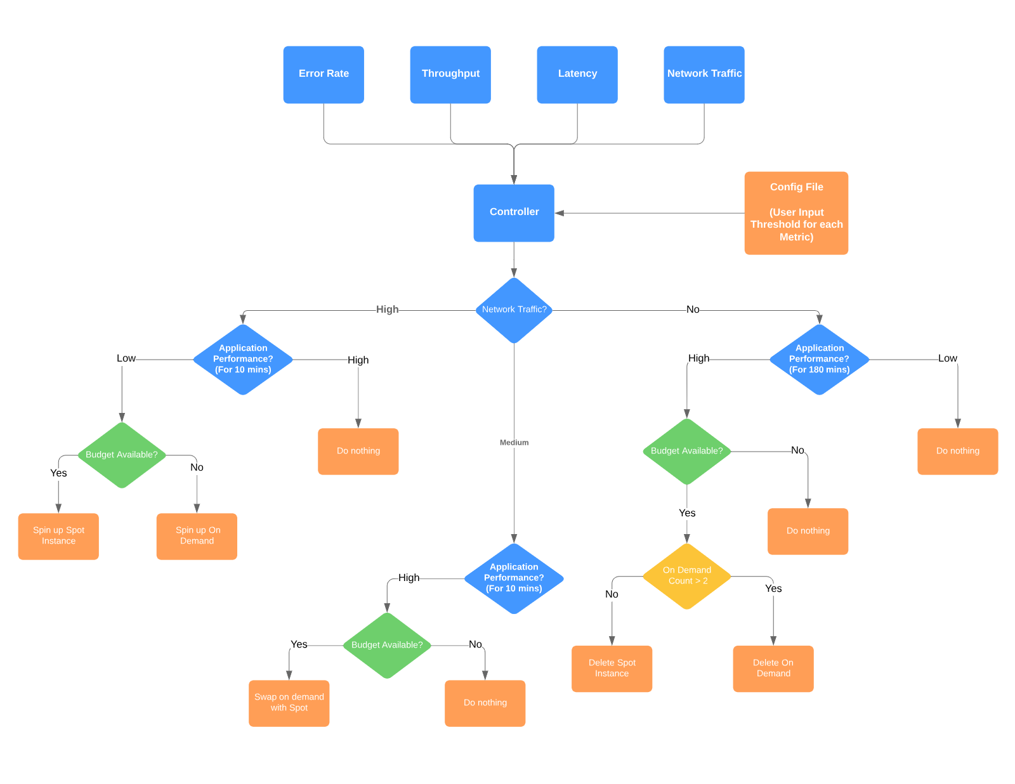
Flowchart of Controller

Slide 10
Algorithm
Our application requires minimum 2 nodes to be on demand to run.
Based on network traffic (load) , our algorithm considers three cases
High Network Traffic ( more than 600 requests per second )
Medium Network Traffic ( between 100 and 600 requests per second )
Low Network Traffic ( less than 100 requests per second )

Slide 11
High Network Traffic
If network_traffic > 600:
If application performance is low for 10 mins:
If budget available:
Spin up a Spot instance scale up the application
Else:
Spin up an On demand and scale up the application
Else
Application is running smoothly, do nothing

Slide 12
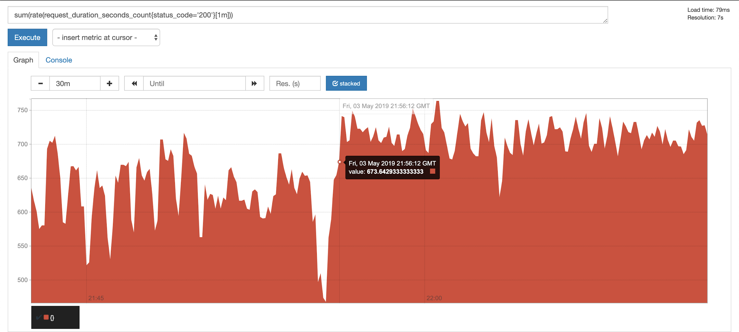
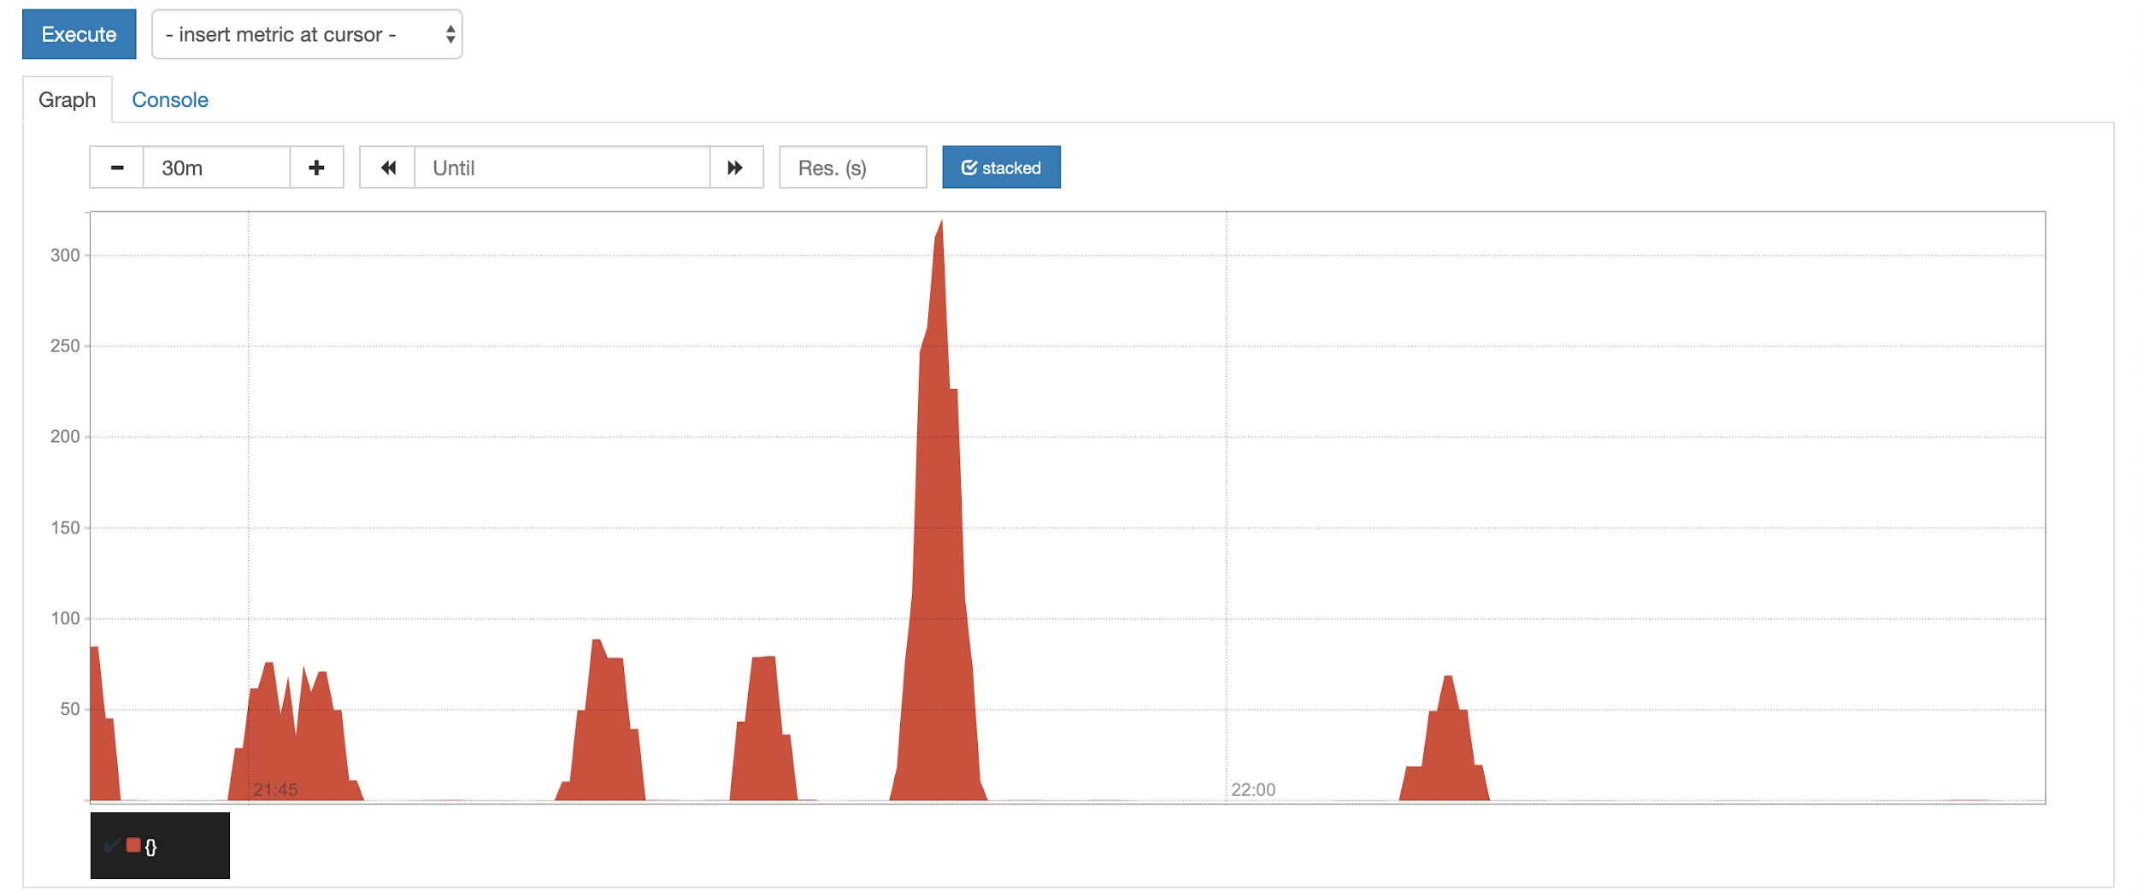
Throughput vs time
Error rate vs time

Slide 13
Moderate Network Traffic
If 100 < network_traffic < 600:
If application performance is high for 180 mins:
If budget available:
Scale down
Delete on demand
Spin up a spot
Scale up
Else:
Budget not available, do nothing

Slide 14
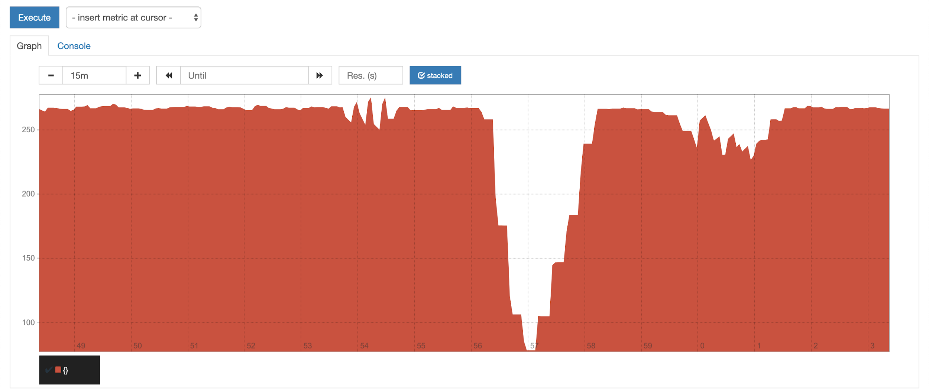
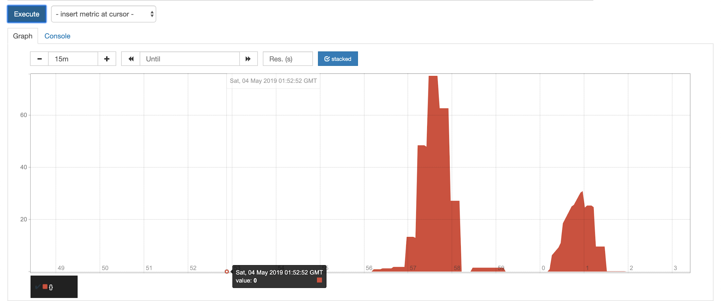
Throughput vs time
Error rate vs time

Slide 15
Low Network Traffic
If network_traffic < 100:
If application performance stable from 180 mins:
If budget available :
Scale down
If On demand nodes > 2
Delete an On-Demand Node
Else
Delete Spot instance

Slide 16
Spot Termination
Before we spin up a Spot instance, we have to set a max bidding price.
Spot Instances can be taken away at any time due to following reasons:
Price : The Spot price is greater than your maximum bidding price.
Capacity – If there are not enough unused EC2 instances to meet the demand for Spot Instances, Amazon EC2 interrupts Spot Instances. The order in which the instances are interrupted is determined by Amazon EC2.

Slide 17
Handling Spot Termination
Controller constantly checks for ‘to be terminated’ flag of Spot Instances.
If to_be_terminated = True:
Scale down the application
Drain the spot instance
If budget available :
Spin up a spot instance
Else
Spin up an On demand Instance

Slide 18
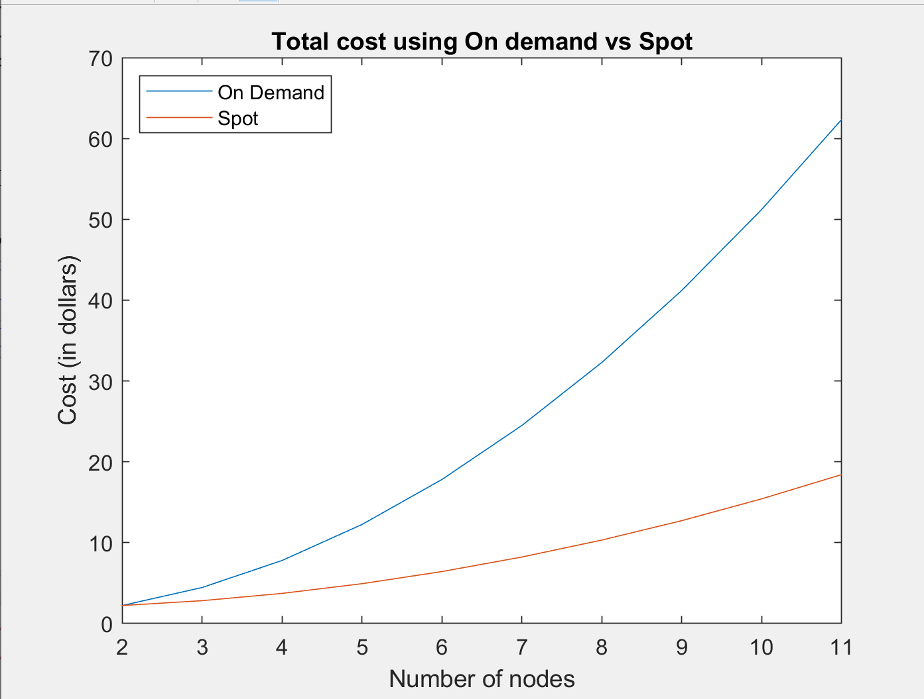
Cost Comparison
Notes:
// add line with cost of eks
// explain size and cost of node
// expected cost savings of a month based on 1 day costs

Slide 19
To summarize
We deployed our application on AWS
Scrapped metrics from the application endpoint using Prometheus.
Developed a controller which will be continuously comparing the scrapped metrics vs threshold metrics.
After the comparisons, the controller will take an action to manage the cluster using kops.
These action make sure that the application is stable and the cost is saved.

Slide 20
What did we learn from this project ??

Slide 21
Using our product, you can run your application on AWS spot instances while saving money without worrying much about maintaining the SLA.

Slide 22
Future Scope
Control eviction of pods in a better way
Deploy and manage multiple application on the same cluster using the controller
Add a machine learning model to predict the termination of spot instance, so that the controller is more prepared

